Slide 1

NBA Shot Quality Capstone
Measuring shot quality to separate shot selection from shot-making skill
Cole Campbell · Project Lead / Literature Review & Ethics Marc Rajesh · Modeling Lead Calder Wyllie · EDA & Visualization Lead Germain Meza · Data Engineer
DAT 490 — Data Science Capstone · Summer A 2026
Notes:
Title card. This stays on screen during Cole's opening line. Final assembled video order: Cole (open) → Germain → Calder → Marc → Cole (close).

Slide 2
PRESENTATION ROADMAP
What we'll cover — and who presents it
1
Project Overview & Research Questions
Cole Campbell
~3 min
2
Data & Engineering
Germain Meza
~5 min
3
Exploratory Analysis & Visualization
Calder Wyllie
~5 min
4
Methodology, Modeling & Results
Marc Rajesh
~5 min
5
Ethics, Recommendations & Conclusion
Cole Campbell
~2 min
NBA Shot Quality Capstone — DAT 490 (Summer A 2026)
Notes:
Cole (opening): 'Here's how the next twenty minutes are laid out. I'll set up the project and our research questions, then Germain covers the data and pipeline, Calder walks through what the data shows, Marc presents the model and results, and I'll close on ethics and where we'd take this next.'

Slide 3
1
SEGMENT 1
Project Overview & Research Questions
Cole Campbell
Project Lead / Literature Review & Ethics
⏱ ~3 min
Notes:
Cole records here. This is the opening clip of the assembled video.

Slide 4
THE PROBLEM · COLE
Two players, same FG% — very different shots
Our analysis is built for the National Basketball Association — the organization at the center of the work.
Traditional stats like field goal percentage treat every made shot the same.
But two players with identical FG% can take completely different shots — one wide open at the rim, one contested from 25 feet.
We set out to separate what FG% blends together:
Shot selection — how hard the shots you take are
Shot-making skill — whether you beat that difficulty
~2 million
tracked shots, 2013-14 to present
30
~$11B
franchises
annual revenue
Optical tracking since 2013-14
a decade of shot-by-shot data — our foundation
NBA Shot Quality Capstone — DAT 490 (Summer A 2026)
Notes:
Cole: 'I'm Cole Campbell, project lead. Our capstone is built for the NBA — the organization at the center of our analysis. Here's the problem. Traditional stats like field goal percentage treat every made shot the same, but two players with the same percentage can be taking completely different shots — one wide open at the rim, the other contested from 25 feet. FG% credits both equally. We wanted to separate the two things it blends: shot selection — how hard the shots you take are — and shot-making skill — whether you actually beat that difficulty. The NBA has the data to do this: since 2013-14, optical cameras have tracked roughly two million shots, and that decade of data is what we built on.'

Slide 5
RESEARCH QUESTIONS · COLE
Three questions we carried through the whole project
RQ1
Which players and teams consistently outperform their expected shot value — and what distinguishes them?
RQ2
How has shot success by court location changed across the 2013-present tracking era?
RQ3
Does a shot-quality-adjusted player ranking differ from traditional efficiency metrics (FG%, eFG%, TS%)?
NBA Shot Quality Capstone — DAT 490 (Summer A 2026)
Notes:
Cole: 'That problem gave us three research questions. One — which players and teams consistently outperform their expected shot value, and what distinguishes them. Two — how shot success by court location has changed across the tracking era; this is the three-point revolution. And three — does a shot-quality-adjusted ranking of players actually differ from traditional metrics like FG% and eFG%. We carried all three through the full analysis; we didn't drop any.'

Slide 6
LITERATURE REVIEW · COLE
Where our work sits in the research
The analytics era
Shot-quality & EPV models
Evaluation & ethics
Dean Oliver's tempo-based thinking moved the league beyond per-game averages to points-per-possession and the "four factors."
Cervone et al. (MIT) score the value of a possession as it unfolds — the modeling tradition our shot-quality model builds on.
Muller's "tyranny of metrics" and Thomas & Uminsky warn against leaning on any single number — cautions we take seriously.
NBA Shot Quality Capstone — DAT 490 (Summer A 2026)
Notes:
Cole: 'Our work sits at the intersection of three threads in the research. First, the analytics era itself — Dean Oliver's tempo-based thinking that pushed the league past per-game averages. Second, shot-quality and expected-possession-value models — the Cervone work out of MIT that scores a possession as it unfolds; that's the modeling tradition we build on. And third, the player-evaluation and ethics literature — Muller's tyranny of metrics, and Thomas and Uminsky on the danger of any single number. We borrow the modeling from the second thread and take the cautions from the third seriously. With that setup, I'll hand off to Germain on the data.'

Slide 7
2
SEGMENT 2
Data & Engineering
Germain Meza
Data Engineer
⏱ ~5 min
Notes:
Germain records here.

Slide 8
DATA SOURCES · GERMAIN
Three sources, all keyed to NBA.com IDs
Primary — NBA Stats API
ID-based joins
Via the open-source nba_api package: shot detail, game logs, players, and teams for every field goal from 2013-14 to today.
player_id · team_id · game_id — reliable and reproducible, never name-matched
Kaggle — 2014-15 Shot Logs
~128,000 shots that include the per-shot tracking features (defender distance, shot clock, touch time, dribbles).
1 enriched table
Kaggle — NBA Stats (1947-present)
every row = one shot, carrying its game, shooter, and team context
Long-horizon player history for context on players whose careers predate the tracking era.
NBA Shot Quality Capstone — DAT 490 (Summer A 2026)
Notes:
Germain: 'Thanks Cole. I'm Germain Meza, the data engineer. Everything you'll see rests on the data. We pulled from three sources, all keyed to NBA.com identifiers, so every join is ID-based, not name-based. The primary source is the NBA's official Stats API, through the open-source nba_api package — shot detail, game logs, players, and teams for every field goal from 2013-14 to today. We supplemented it with two Kaggle sets: a 2014-15 shot-logs set of about 128,000 shots that — and this part matters — includes the per-shot tracking features, and a 1947-to-present set for long-term player history. Everything lands in one enriched shot-level table.'

Slide 9
PIPELINE & SCALE · GERMAIN
2.9M shots, 13 seasons — built to not break
Pull
(NBA API + Kaggle)
→
Clean
(per-table)
→
Enrich
(one shot-level table)
→
Model-ready
(Parquet)
~2.9 million shot records across 13 seasons — stored as Parquet, so raw volume was never the bottleneck.
The join trap: the NBA API stores games at the team-game level — each game appears twice, once per team.
Joining on game alone would have silently doubled our shots, so we joined on game + team + season together.
We ran row-count checks before and after every merge to confirm nothing duplicated or dropped.
NBA Shot Quality Capstone — DAT 490 (Summer A 2026)
Notes:
Germain: 'The full enriched dataset is about 2.9 million shot records across 13 seasons. We stored everything as Parquet, which kept processing fast even at that size — so raw volume was never the real problem. The pipeline runs in four stages: pull from the sources, clean each table, enrich into one shot-level table where every row carries its own context plus the game, shooter, and team context, then hand that off model-ready. The trickiest part was the joins. The NBA API stores games at the team-game level — each game shows up twice, once per team — so joining on game alone would have silently doubled our shots. We joined on game, team, and season together, and ran row-count checks before and after every merge to be sure nothing duplicated or dropped.'

Slide 10
DATA QUALITY & THE KEY CONSTRAINT · GERMAIN
Clean data — but tracking detail exists for one season
Good news: the data was clean and well organized.
Rows missing critical location fields were a tiny fraction — dropped with minimal impact; dates standardized.
So we didn't spend the project fighting messy data — we spent it on the analysis.
The constraint that shaped everything
The contextual tracking features that make shot quality measurable — defender distance, touch time, dribbles, shot clock — are only publicly available for the 2014-15 season.
So we split deliberately: the detailed 2014-15 logs power the shot-quality model (RQ1 & RQ3); the full 13 seasons power the location-over-time analysis (RQ2).
NBA Shot Quality Capstone — DAT 490 (Summer A 2026)
Notes:
Germain: 'On data quality, we got lucky — the data was clean and well organized. The rows missing critical location fields were a tiny fraction, we dropped them with minimal impact, and we standardized all the dates. So we didn't burn the project fighting messy data. But there's one constraint that shaped everything: the contextual tracking features that make shot quality measurable — defender distance, touch time, dribbles, shot clock — are only publicly available for the 2014-15 season. Every other season gives us location and outcome, but not that per-shot detail. So we made a deliberate split: the detailed 2014-15 logs power the shot-quality model behind RQ1 and RQ3, and the full thirteen seasons power the location analysis in RQ2.'

Slide 11
ENGINEERING CHALLENGES · GERMAIN
What we hit — and how we fixed it
Windows 260-char path limit
Parquet writes & installs failed in a long directory.
Moved the repo to a short path: C:\nba.
Anaconda vs .venv clash
Phantom "module not found" errors on installed packages.
Standardized on a dedicated .venv for everyone.
XGBoost wouldn't load on Mac
A teammate couldn't run the model locally.
Saved model outputs as small CSVs the viz code reads directly.
NBA Shot Quality Capstone — DAT 490 (Summer A 2026)
Notes:
Germain: 'A few engineering challenges worth naming. First, Windows' 260-character path limit broke our Parquet writes until we moved the repo to a short path, C-colon-backslash-nba. Second, a clash between a system Anaconda install and our virtual environment caused phantom module-not-found errors — we fixed it by standardizing on a dedicated .venv for everyone. And third, XGBoost wouldn't load on a teammate's Mac, so rather than fight local setups, we saved the model outputs as small CSVs in the repo and had the visualization code read those directly — so anyone can regenerate the charts without running the model. With the data in hand, Calder will take you into what it actually shows.'

Slide 12
3
SEGMENT 3
Exploratory Analysis & Visualization
Calder Wyllie
EDA & Visualization Lead
⏱ ~5 min
Notes:
Calder records here.

Slide 13
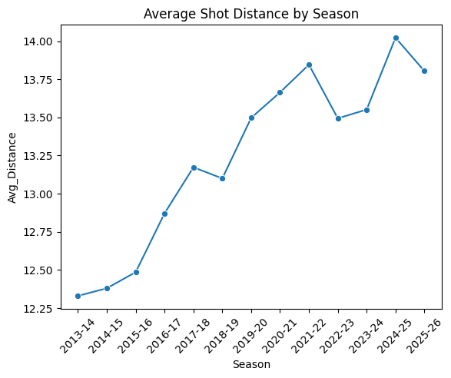
EXPLORING THE DATA · CALDER
Before modeling: how has shooting changed?
Before any modeling, we wanted to understand the shooting landscape across all 13 seasons.
We focused on the variables tied to whether a shot goes in: distance, court location and zone, shot type, and the made/missed flag.
First big picture — shot selection has changed dramatically.
Average shot distance climbs steadily through the late 2010s, then plateaus — the fingerprint of a league that moved outward and settled into a new normal.
NBA Shot Quality Capstone — DAT 490 (Summer A 2026)
Notes:
Calder: 'Thanks Germain. I'm Calder Wyllie — I led the exploratory analysis and visualization. Before any modeling, we wanted to understand the shooting landscape. We focused on the variables tied to whether a shot goes in — distance, court location and zone, shot type, and the made-or-missed flag — across all thirteen seasons. And the first big picture is that shot selection has changed dramatically. This chart is average shot distance by season: it climbs steadily through the late 2010s and then plateaus — the fingerprint of a league that moved outward and then settled into a new normal.'

Slide 14
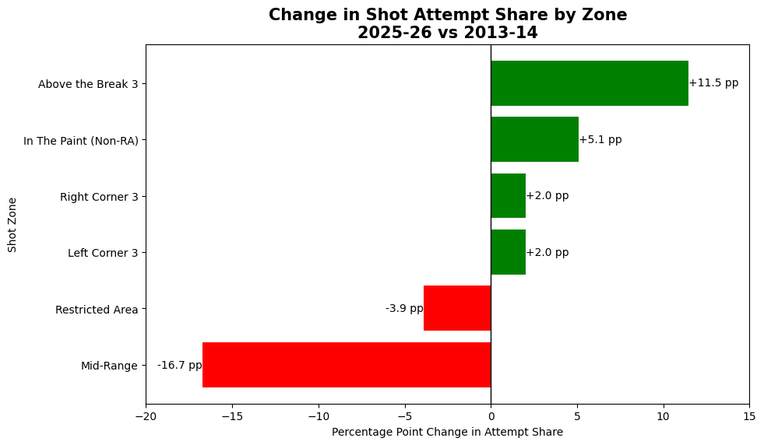
RQ2 · THE THREE-POINT REVOLUTION · CALDER
Where teams shoot has been rebuilt
Comparing 2013-14 to 2025-26 by zone:
Mid-range: ~27% → ~10% of attempts (−16.7 pts — the biggest move)
Above-the-break 3: +11.5 pts
This is the three-point revolution — and it shows up cleanly in our data.
That's the heart of RQ2: the geography of shooting has been completely rebuilt over the era.
NBA Shot Quality Capstone — DAT 490 (Summer A 2026)
Notes:
Calder: 'Here's that shift by zone. Between 2013-14 and 2025-26, the mid-range collapsed — from about 27% of all attempts down to about 10%, a 17-percentage-point drop, the single biggest move in the data. Above-the-break threes went the other way, up about 11 points. This is the three-point revolution, and it shows up cleanly. That's the heart of research question two — where teams shoot has been completely rebuilt over the era.'

Slide 15
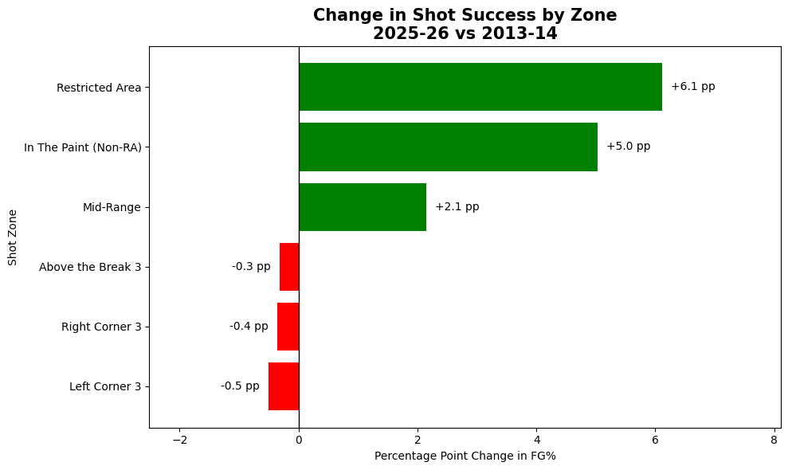
RQ2 · EFFICIENCY HELD STEADY · CALDER
Where they shoot changed — how well, didn't
While shot location changed enormously, FG% by zone barely moved.
The efficiency ranking stayed stable: restricted area most efficient, corners reliable, above-the-break threes the lowest-percentage shot.
Even as 3-point volume exploded, 3-point % ticked down slightly — more players shooting from tougher spots.
The one real gain: shooting at the rim rose ~6 points.
NBA Shot Quality Capstone — DAT 490 (Summer A 2026)
Notes:
Calder: 'But here's the more interesting part. While where teams shoot changed enormously, how well they shoot from each zone barely moved. The efficiency ranking stayed stable the whole time — restricted area always the most efficient, corners reliable, above-the-break threes the lowest-percentage shot. In fact, even as three-point volume exploded, three-point percentage actually ticked down slightly, because more players were taking them from tougher spots. The one real gain was at the rim — restricted-area shooting rose about six points.'

Slide 16
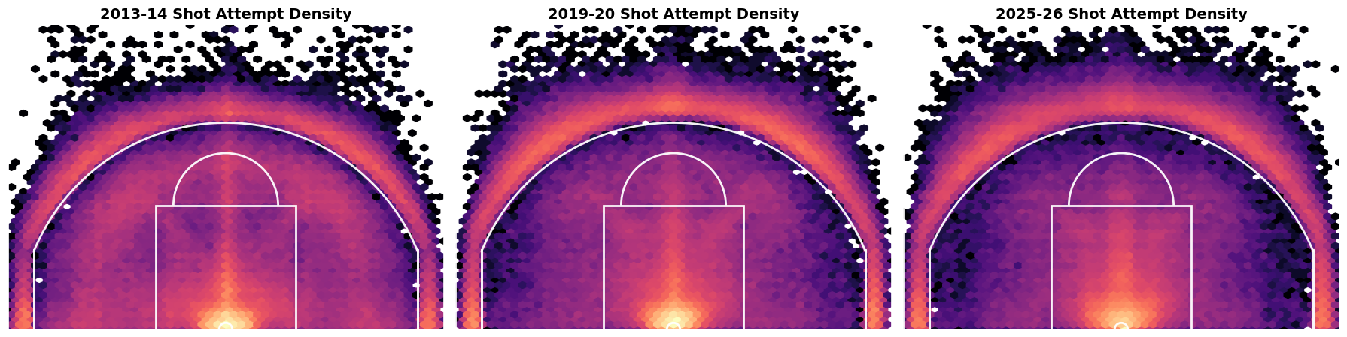
RQ2 · TAKEAWAY · CALDER
Selection changed — not league-wide shooting
Across the era, attempts migrate outward — the mid-range hollows out while volume concentrates at the rim and behind the arc — yet the efficiency surface underneath stays stable. The transformation was about shot selection, not getting better everywhere at once. That sets up the modeling.
NBA Shot Quality Capstone — DAT 490 (Summer A 2026)
Notes:
Calder: 'These shot-density maps make it tangible — moving across the era, the cluster of attempts migrates outward, the mid-range hollows out, and volume concentrates at the rim and behind the arc, while the efficiency surface underneath stays remarkably stable. So the takeaway for RQ2 is clear: the league's transformation was about shot selection, not a league-wide jump in shooting skill. Teams moved their shots toward the most efficient zones rather than getting better everywhere at once. That sets up the modeling — Marc, over to you.'

Slide 17
4
SEGMENT 4
Methodology, Modeling & Results
Marc Rajesh
Modeling Lead
⏱ ~5 min
Notes:
Marc records here.

Slide 18
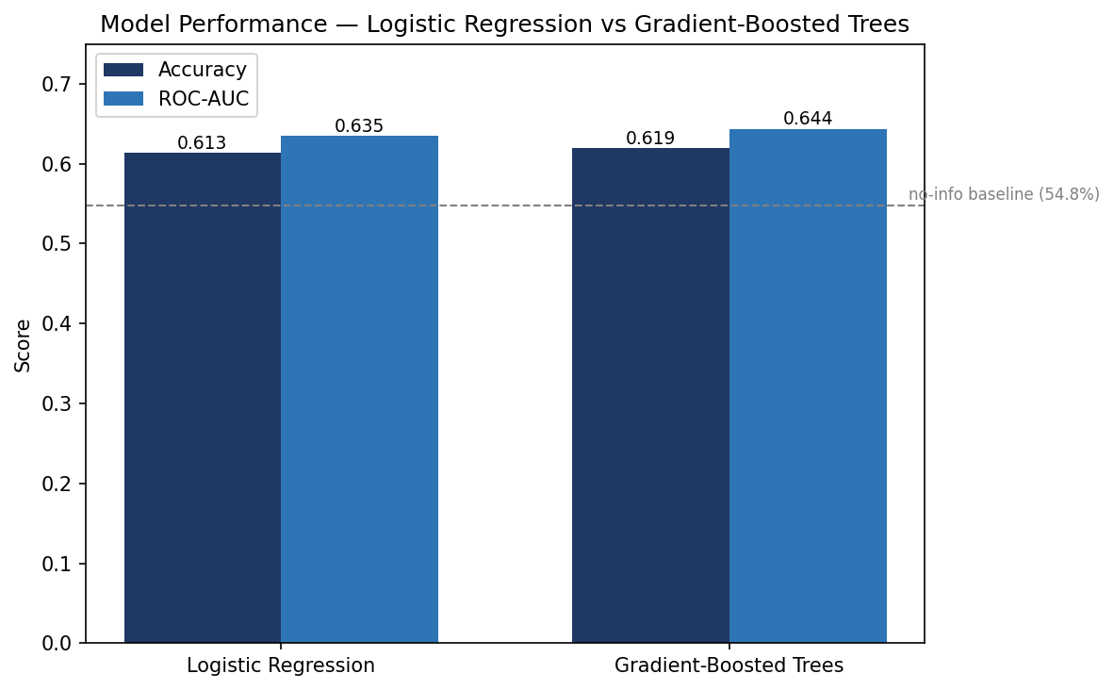
THE SHOT-SUCCESS MODEL · MARC
Logistic baseline → gradient-boosted trees
One model predicts whether a single shot goes in, given its context — trained on 2014-15 (the season with tracking features).
Logistic regression baseline — interpretable; ~61% accuracy, and coefficients made basketball sense (distance hurts, space helps).
XGBoost — captures interactions the linear model can't (space × distance × shot clock).
We kept features simple and interpretable rather than chasing a marginally better score.
61.9% acc · 0.644 AUC
XGBoost, vs a 54.8% always-guess-miss baseline
NBA Shot Quality Capstone — DAT 490 (Summer A 2026)
Notes:
Marc: 'Thanks Calder. I'm Marc Rajesh, the modeling lead. Everything here rests on one model that predicts whether a single shot goes in, given its context. We trained it on 2014-15 — the one year with the per-shot tracking features Germain mentioned. We started with logistic regression as a baseline because it's interpretable: about 61% accuracy, and reassuringly its coefficients made basketball sense — distance hurts your chances most, defender space helps most. Then we moved to a gradient-boosted tree model, XGBoost, to capture interactions the linear model can't — the value of an extra foot of space depends on distance, which depends on the shot clock. The boosted model reached about 62% accuracy and a 0.644 AUC, comfortably above the 54.8% you'd get by always guessing miss. We deliberately kept the feature set simple and interpretable rather than chasing a marginally better score.'

Slide 19
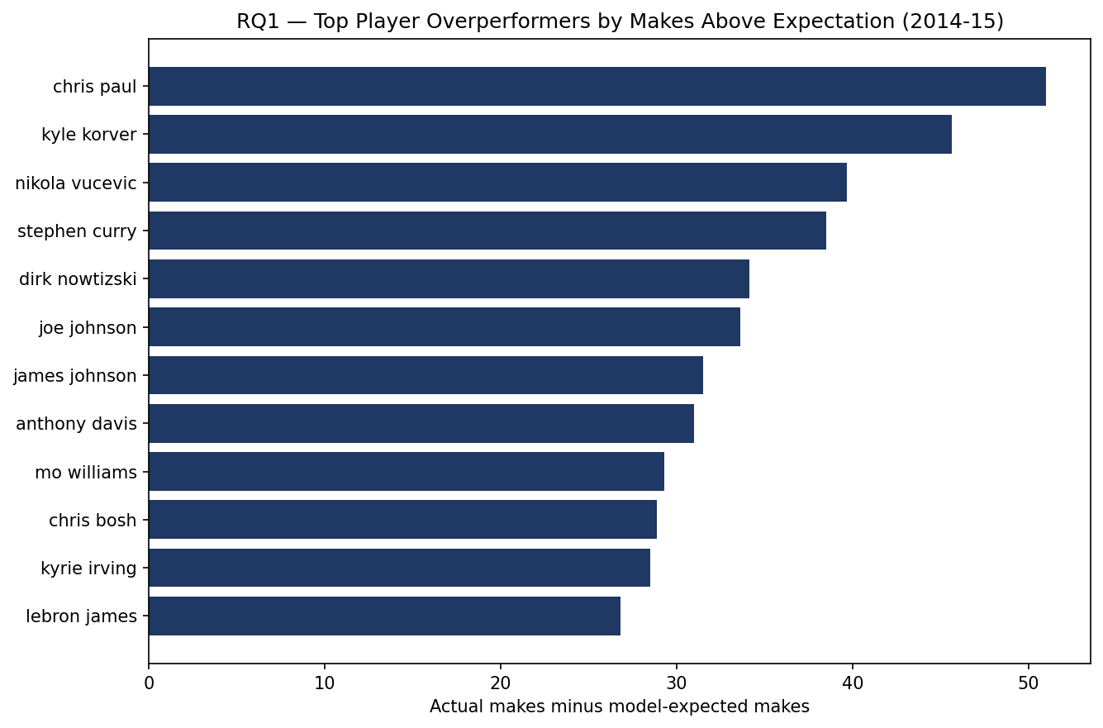
RQ1 · OVERPERFORMERS · MARC
Residuals: who beats their expected shots
We scored every shot and computed residuals — actual makes minus expected makes.
A consistently positive residual = a player beating the difficulty of the shots they take.
Top 2014-15 overperformers:
Chris Paul +51 makes above expected
Kyle Korver +9.5% on ~500 shots
Team: Clippers led at +78
NBA Shot Quality Capstone — DAT 490 (Summer A 2026)
Notes:
Marc: 'With that model, we scored every shot and computed residuals — actual makes minus expected makes. A consistently positive residual means a player beat the difficulty of the shots they took. That's research question one. In 2014-15, the top overperformers were a mix of elite shooters and creators: Chris Paul at plus-51 makes above expected, Kyle Korver converting about 9.5 points above expectation on nearly 500 shots, then Vučević and Curry. At the team level the Clippers led at plus-78, well ahead of the field.'

Slide 20
RQ1 · WHAT DISTINGUISHES THEM · MARC
K-means → four overperformer archetypes
On-Ball Creators
37 players
Catch-and-Shoot
36 players
Chris Paul, Stephen Curry, Kyrie Irving
Kyle Korver, Klay Thompson, Wesley Matthews
Interior Finishers
29 players
Mid-Range Scorers
27 players
Anthony Davis, DeAndre Jordan, Nikola Vučević
Dirk Nowitzki, Chris Bosh, Carmelo Anthony
NBA Shot Quality Capstone — DAT 490 (Summer A 2026)
Notes:
Marc: 'Knowing who overperforms is only half of it. To answer what distinguishes them, we clustered the overperformers with k-means on their shot-selection features — distance, defender distance, touch time, dribbles, three-point rate. Four clean archetypes fell out: on-ball creators like Paul and Curry; catch-and-shoot specialists like Korver and Thompson; interior finishers like Davis and Jordan; and mid-range scorers like Nowitzki and Bosh. The point is that overperformance isn't one type of player — the model rewards each role for doing its job well.'

Slide 21
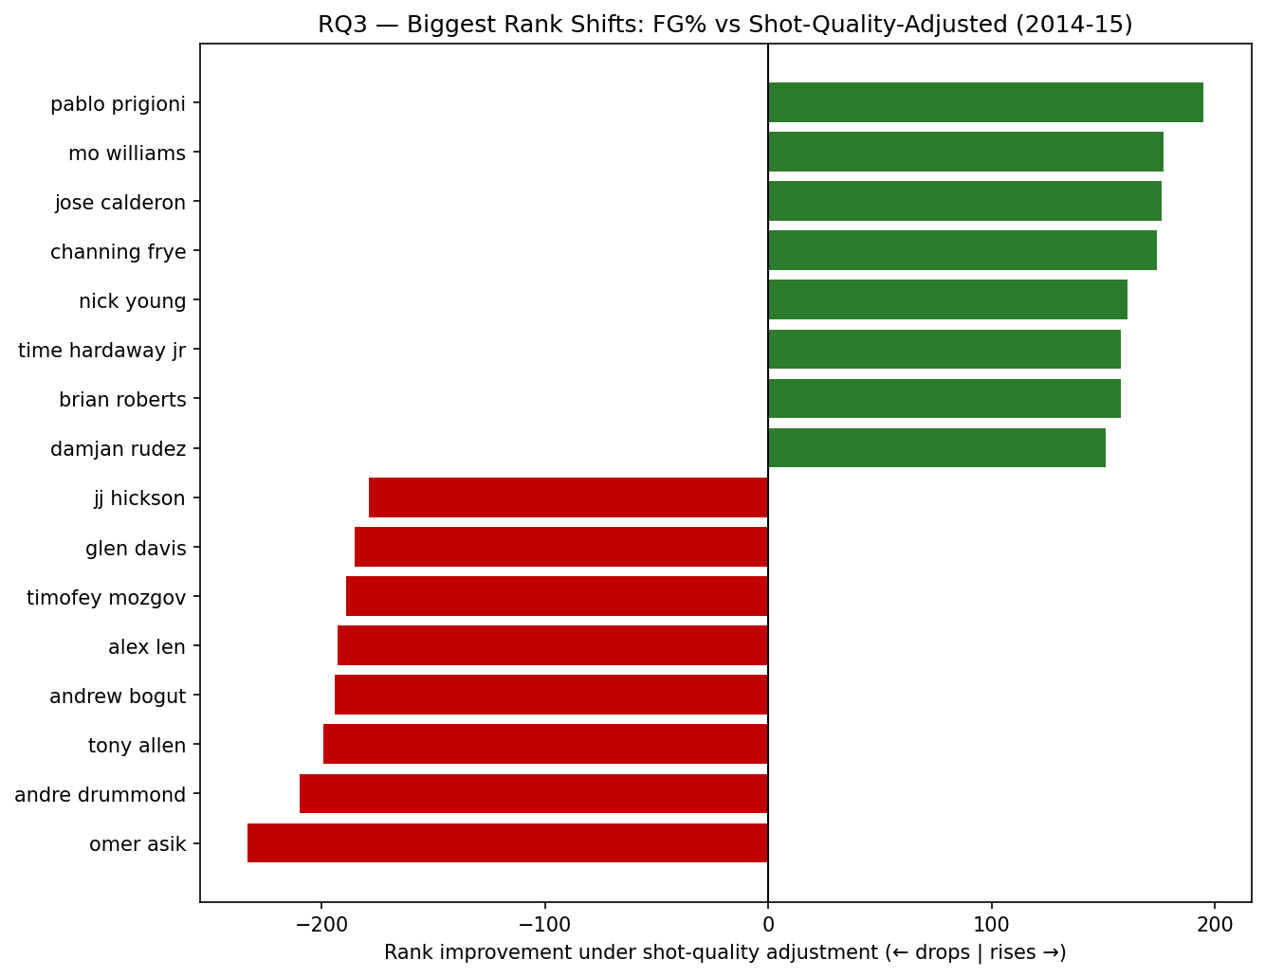
RQ3 · ADJUSTED vs TRADITIONAL · MARC
A meaningfully different ranking
Spearman correlation vs traditional metrics:
vs FG%: ρ = 0.39 (well below 1 — a different story)
vs eFG%: ρ = 0.59
Movers sort cleanly by type:
Risers — perimeter shooters (Prigioni +195 spots)
Fallers — interior, easy shots (Asik −233 spots)
The metric working as designed: credit for hard shots, little for easy ones.
NBA Shot Quality Capstone — DAT 490 (Summer A 2026)
Notes:
Marc: 'Research question three asks whether a shot-quality-adjusted ranking actually tells a different story than traditional metrics. We compared our adjusted metric against FG% and eFG% using Spearman rank correlation. Against raw FG% the correlation was just 0.39 — well below one — so yes, it's a meaningfully different ranking. And the players who move sort cleanly by type: the biggest risers are perimeter shooters who make contested shots — Pablo Prigioni climbs about 195 spots — and the biggest fallers are interior players who live on easy shots near the rim, like Omer Asik dropping 233. That's the metric working exactly as designed — credit for hard shots, little for easy ones. Cole will close us out.'

Slide 22
5
SEGMENT 5
Ethics, Recommendations & Conclusion
Cole Campbell
Project Lead / Literature Review & Ethics
⏱ ~2 min
Notes:
Cole records here — the closing clip of the assembled video.

Slide 23
ETHICS · COLE
The metric measures one thing — use it that way
Our metric measures shot-making only — not defense, rebounding, or playmaking.
A player who ranks low isn't necessarily a bad player; the thing that makes them valuable may not be what this measures.
Responsible use:
One input among many — never a complete verdict on a player
Always read in the context of a player's role
Honest about limits — built on a single season; a moment in time, not a permanent truth
NBA Shot Quality Capstone — DAT 490 (Summer A 2026)
Notes:
Cole: 'Thanks Marc. Closing on ethics and where this goes. The most important caveat: our metric measures one thing — shot-making. It says nothing about defense, rebounding, or playmaking. A center who ranks low isn't a bad player; the thing that makes him valuable just isn't what this measures. So the responsible use is as one input among many, always read in the context of a player's role, and honest about its limits — it's built on a single season and describes a moment in time, not a permanent verdict. Used as a complete judgment of a player, it would mislead.'

Slide 24
RECOMMENDATIONS & NEXT STEPS · COLE
With 6–12 months instead of two
1
2
3
Better data
Richer modeling
Broader metric
Pursue multi-season tracking features so the model isn't tied to a single year.
Build toward expected-possession-value approaches that score a possession as it unfolds.
Combine shot quality with the other dimensions of player value — a fuller picture.
"What we lacked was not the idea, but the time."
NBA Shot Quality Capstone — DAT 490 (Summer A 2026)
Notes:
Cole: 'If we had six to twelve months instead of two, three things would change. First and most important, the data — we'd pursue multi-season tracking features so the model isn't tied to one year. Second, the modeling — we'd build toward the richer expected-possession-value approaches that score a possession as it unfolds. And third, we'd broaden the metric into a fuller picture of player value that includes the other things a player does. What we lacked wasn't the idea — it was the time.'

Slide 25
CONCLUSION · COLE
What we found
Shot context is genuinely predictive of whether a shot goes in.
Players who beat the model span distinct, recognizable roles — not one type.
The league's decade of change was about shot selection, not shooting better everywhere.
A shot-quality view reorders players in a way traditional metrics miss.
NBA Shot Quality Capstone — DAT 490 (Summer A 2026)
Notes:
Cole: 'To wrap up: shot context really is predictive of whether a shot goes in. The players who beat the model span distinct, recognizable roles. The league's decade of change was about shot selection, not shooting better everywhere. And a shot-quality view reorders players in a way traditional metrics miss. Thanks for watching — we're happy to take questions.'

Slide 26
Thank you
Questions welcome
Cole Campbell · Marc Rajesh · Calder Wyllie · Germain Meza
NBA Shot Quality Capstone · DAT 490 — Summer A 2026
Notes:
Closing card — stays up at the end of Cole's closing clip.

